Slide 1
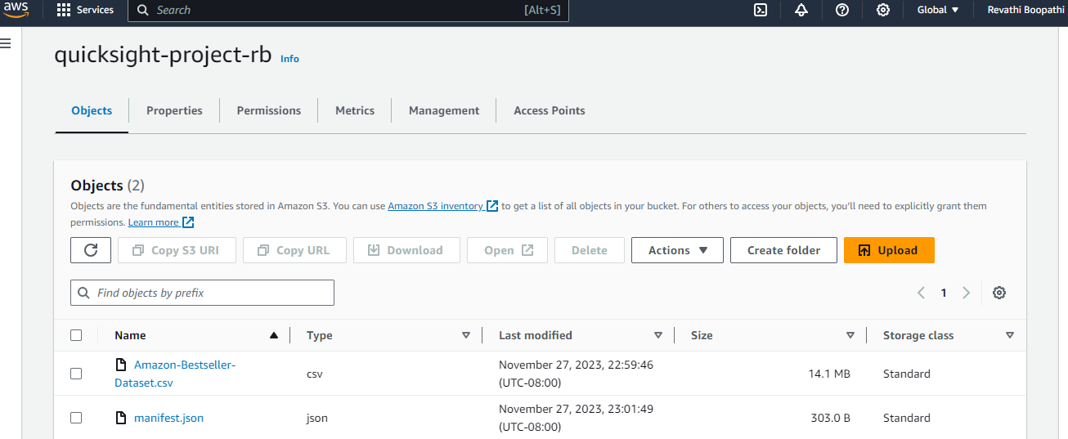
Screenshots

Slide 2
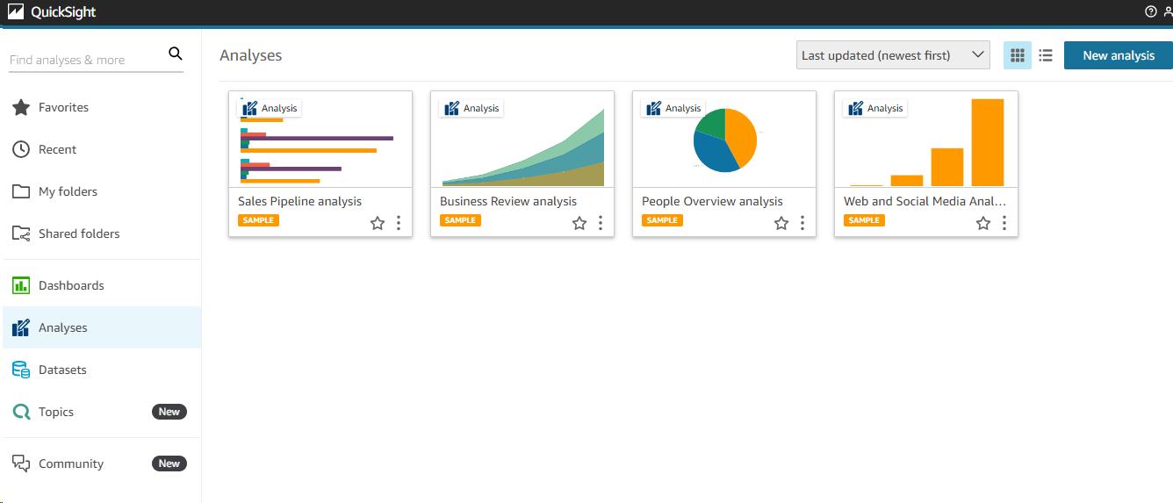
Screenshots - QuickSight

Slide 3
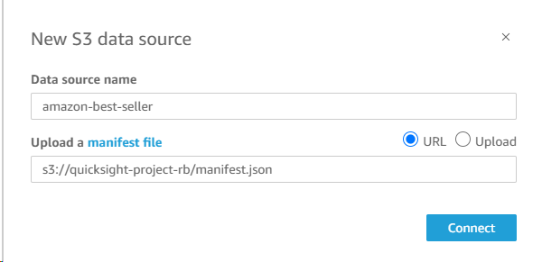
Screenshots - QuickSight

Slide 4
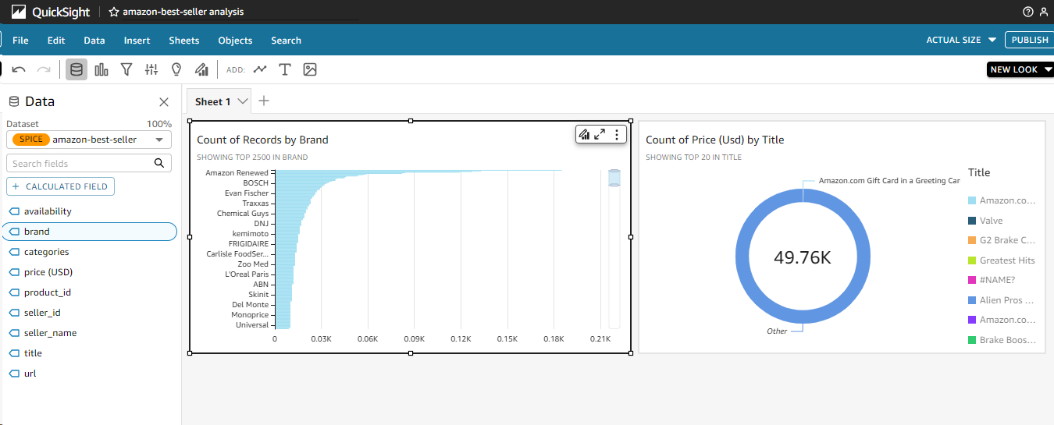
Screenshots – QuickSight visuals

Slide 5
References
https://www.youtube.com/watch?v=4-8cXuZzKTg
https://www.youtube.com/watch?v=Kp4Nvp6Xlb0

